Slide 1

Powerful
Presentation
Facilitator: Brian Lee 08-22~23-2002 Hong Kong
Notes:
开场白：
这次培训，我投入了许多心血。做准备，虽然我上了不止10次，但是我还是修改了很多。
我希望我们都有收获。
希望每人都能帮大家忙，学一两招，我也有心得，又可以修改。

Slide 2
Welcome to the training !!!
Prepare for the challenge !!!

Slide 3


Why talking about presentation?
The way
in which something is said,shown, explained,etc., to others.
Notes:
Some presenter just speaking to themselves.

Slide 4
Why talking about presentation?
Critical skills in Effective communication
in business
Present yourself professionally
  At meetings
  Pitch sessions
  Training classes
  Sales presentations.
Notes:
Some presenter just speaking to themselves.

Slide 5
Why talking about presentation?
Critical skills in Effective communication
in business
Effective presentations
  Establish credibility !
  Increased visibility !
  Impact your career !
Notes:
Some presenter just speaking to themselves.

Slide 6

Why talking about presentation?
Is it a hard job to do good presentation?
What bothers you much?
  Fear?
  Anxiety?
  Don’t know how to prepare?
  Not good at delivery?
  What else….Putong hua?
Notes:
Some presenter just speaking to themselves.

Slide 7
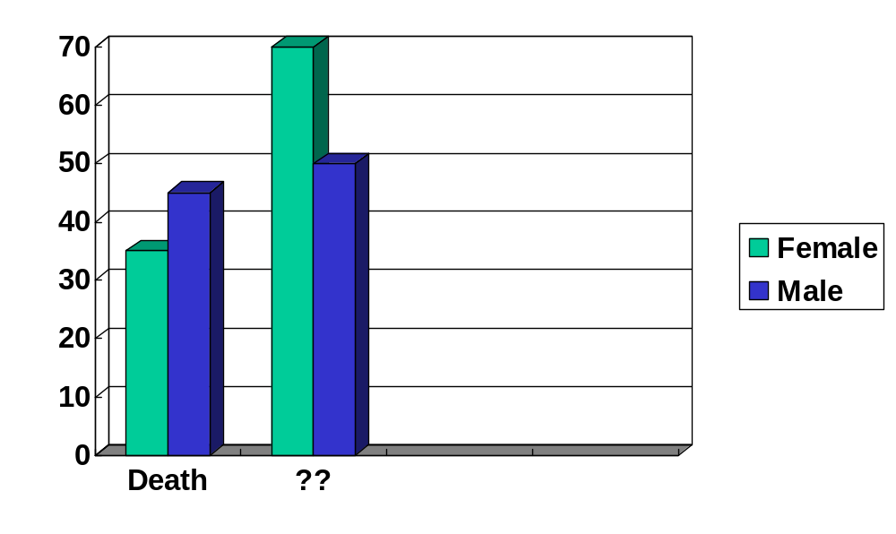
What is the greatest fear of Americans?
Speaking before a large group of people is like having an out-of-body experience !

Slide 8

How often do you feel nervous when doing a presentation?
        A lot.
        Sometimes.
        Once a while.
        Almost never.
        Never
If your answer is not 5,
this training will be helpful to you!

Slide 9
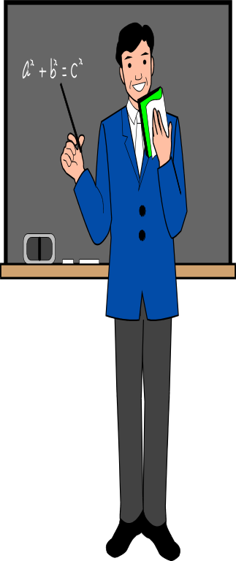
Now that is why we are here today:
Learning how to do a better presentation
  Reduce anxiety
  Better preparation
  Better delivery
  Move the audience to action

Slide 10

And here are our approaches:
I Characteristics of Powerful presentation!
II 8 steps for preparing a presentation!

Slide 11


The learning process:
RECEIVED
UNDERSTOOD
ACCEPTED
PRACTICE
IMPROVED
IMPROVED
IMPROVED
Are you ready ?
Master

Slide 12

PART 1 Characteristics of Powerful presentation
Notes:
Everybody make a list of presentations they have been doing.

Slide 13


Brainstorming
Characteristics a powerful presentation?
Presenter ?
Audience?

Slide 14
Powerful presentation:
Principles.
Presenter.
Characteristics

Slide 15
Principles of powerful presentations:
  Don’t make it a public speech.
  Don’t give more information than audience absolutely need.
  Don’t assume audience’s long attention.
  Don’t forget the purpose .
  Don’t forget to get audience perception.
  Satisfy four criteria.

Slide 16

What is presentation?
The way
in which something is said,shown, explained,etc., to others!
Notes:
Some presenter just speaking to themselves.

Slide 17

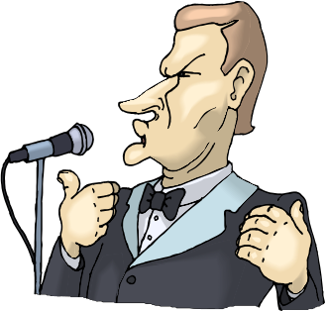
Presentation VS Public Speech
Audience Oriented
Focus on
Speaker Oriented
Focus on
Value
Entertainment

Slide 18
People have
short attention
and retention spans !

Slide 19
The purpose
of every presentation
is to persuade.

Slide 20
Audience’s perception
of the presenter
is much more important than the presenter’s
self-perception

Slide 21
1- attention-getting keep people’s attention
2- meaningful motivate your audience
3- memorable remember what you said
4- activating not just motivating

Slide 22
Powerful presentation:
Principles.
Presenter.
Characteristics

Slide 23

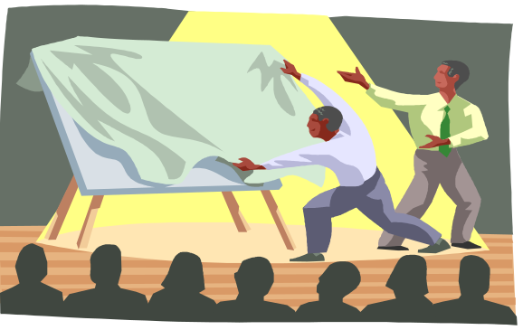
Characteristics of powerful presenter:
  Enthusiasm
  Organization
  Audience-focused
  Flexibility
  Appropriate body language
  Sense of humor
  Appropriate vocabulary
  Varied voice tone
9. Focused on he purpose

Slide 24

A presentation
Is a…
Project

Slide 25
Presentation
Preparation
Delivery
Information
Material
Tools
Image
Process
Tools
Objective
What
When
Where
Who
Time
…
TEST
Slide
Flyer
Copy
Gift
TEST!
Projector
W/Board
Flipchart
Power
Pointer
A/V Sys
Assistant
TEST !
Dress
Express
Procedure
Use
Adjust

Slide 26

A Project needs
good planning
Why are you nervous?
Notes:
Miss word WRONG BUT PREPARED ANSWER
Fashion show
No no ready show
Plan & pain

Slide 27
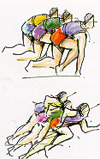
PART II - 8 steps for preparing a presentation
1- Developing your objectives
2- Knowing your audience
3- Stating the main ideas
4- Deciding on Supporting Materials
5- Creating Openers
6- Creating transitions
7- Structuring the main body
8- Preparing strong closing

Slide 28
Step1- Developing your objectives
Think…! Which one you should focus on?
    What am I going to say?
    Why am I giving this presentation?
?
?
?
Design your presentation to support the right answer.

Slide 29

Step1- Developing your objectives
Three questions you should ask yourself:
  What do you want the audience to do as a result of your presentation?
  What do you want to accomplish by giving this presentation?
  What reaction do you want from the people?

Slide 30
Step1- Developing your objectives
Your objectives should be:
  Attainable Measurable Realistic
  Sample format:
  By the conclusion of this presentation, you will_______.
  My objective is to __________.
  I want to talk about ________ So that ____________.

Slide 31
Step1- Developing your objectives
Which of these objectives are realistic?
  Grasp the significance of a public education program
  Identify common verbal stumbling blocks
  Understand the company’s policy
  Support the Union by volunteering or giving money

Slide 32
Step1- Developing your objectives
Using the guidelines discussed , write your objectives for your presentation.
  By the conclusion of this presentation, you will_______.
  My objective is to __________.
  I want to talk about ________ So that ____________.

Slide 33

Step 2- Knowing your audience
The more you know about your audience, the more likely you will succeed with your ideas and the way you present them.

Slide 34

Step 2- Knowing your audience
Talk to the attendees in advance, find out:
  What problems they are having?
  What the most want to gain from the presentation?
  How much time you are going to be investing?
Interview others who have spoken to the audience, find out:
  Reactions and response they received.
Developing surveys or questionnaires, find out:
  Appropriate information to deliver.

Slide 35
Step 3- Stating the main ideas
What ideas will best lead to my objectives?
What ideas do I want my audience to remember the most?
???

Slide 36
Step 3- Stating the main ideas
Main ideas should:
  State conclusion
  Accomplish specific objectives
  Be interesting
  Be few in numbers
???

Slide 37
Step 3- Stating the main ideas
Organizing main ideas:
  Use out line approach
  5W 1H strategy
  Brainstorming or mind-mapping
???

Slide 38

Step 4- Deciding on Supporting Materials
Your sources:
  Inside the organization
    Product information, statistics,reports.
  Outside the organization
    Press, customer feedback
  Personal
    Own ideas, insights, examples

Slide 39
Step 4- Deciding on Supporting Materials
Type of materials:
  Examples,
  Comparison
  Quotations
  Findings
  Statistics
  Graphics
  Audio/Video materials
  Testimony of experts

Slide 40

Step 5- Creating Openers
Openers
  Capture attention
  Introduce the subject
  Establish your credibility

Slide 41
Step 5- Creating Openers
Dos & Don’ts
Please refer to your reading materials

Slide 42

Step 6- Creating transitions
Tie your ideas Together
Keep them short
Use attention-getting statements
Use visual aids
Use appropriate humor or shock statements
Use pauses

Slide 43

Step 7- Structuring the main body
Logical sequences:
  Chronological order ( Past- Present- Future)
  Priority ( Most important- Less important )
  Topical approach ( least – more – most important)
  Spatial arrangement ( Key points related by areas)
  Problem-solution ( Problem- cause- solution)

Slide 44

Step 8- Preparing strong closing
Three objectives
  Summarize the main ideas
  Review the purpose of the presentation
  Call for action

Slide 45

Step 8- Preparing strong closing
Key ingredients of a closing
  Announces the closing
    Let me summarize…
    As a wrap up …….
  Restatement of the key points
    So they can remember
  Summary of the main ideas
    Convince your audience to take action
That’s all, thanks, goodbye!

Slide 46
Step 8- Preparing strong closing
Key ingredients of a closing
  Appropriate benefit statement
    Sell the value again
    Promote their action
  Brief and memorable statement
    But not a poem or not relevant information

Slide 47
Step 8- Preparing strong closing
Types
  Remember what I said at the beginning….
  If you really want to stay in business, stay employed…
  I’m appealing to all of you to become more committed to doing the best you can……
  Well, now that you have heard from me, please turn your attention to Mr. xxx,our president….

Slide 48

Step 8- Preparing strong closing
Don’t do this !!!
  Changing your delivery style
  Stopping without summarizing key points
  Apologizing
  Admitting you have forgotten a point

Slide 49
End of day one
Closing
Notes:
通常提前20分鐘，連接設備，最好自備電源延長線
檢查白板筆是否有水，最好自備白板筆
檢查圖表架紙張是否夠用
投影機提前試好距離(最後能看清)，對焦，亮度。

